Slide 1


ECEN 403 Final Presentation
Team 37
Microhistological Analysis of the Dietary Habits of Sheep: GrazeView AI
Godson Edewor, Arnav Gokhale, Jack Nelson, and Nate Scott

Slide 2
Project Description
Problem Statement:
TAMU AgriLife is currently investigating the Dietary Habits of Sheep and the effect it has on their wool.
This can be a very time consuming effort, when analyzing microscopic samples by hand.

Slide 3
Project Description
Solution Proposal:
GrazeView AI will allow the process of analyzing these microscope slides to become automated.
This will save TAMU AgriLife both time and money spent in training individuals that analyze by hand.

Slide 4
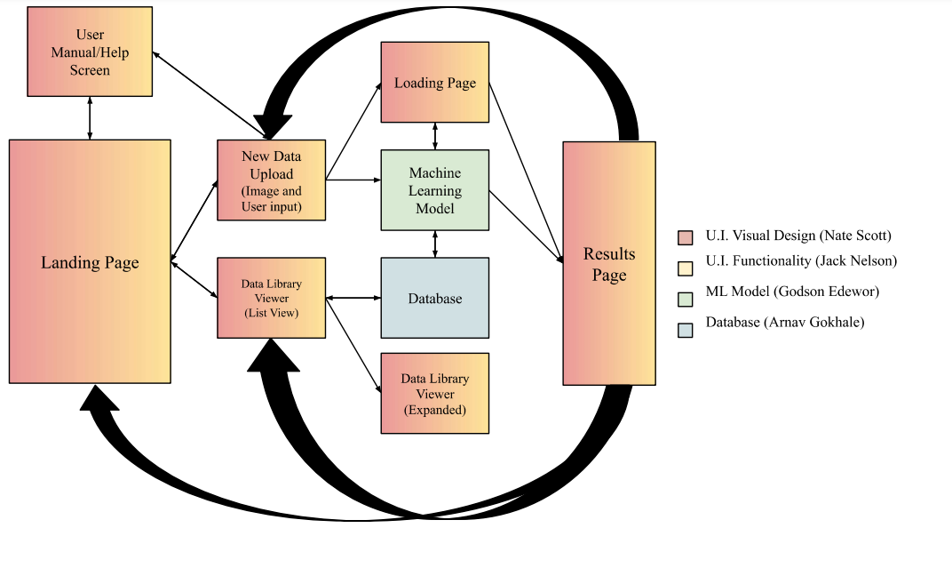
System Overview

Slide 5
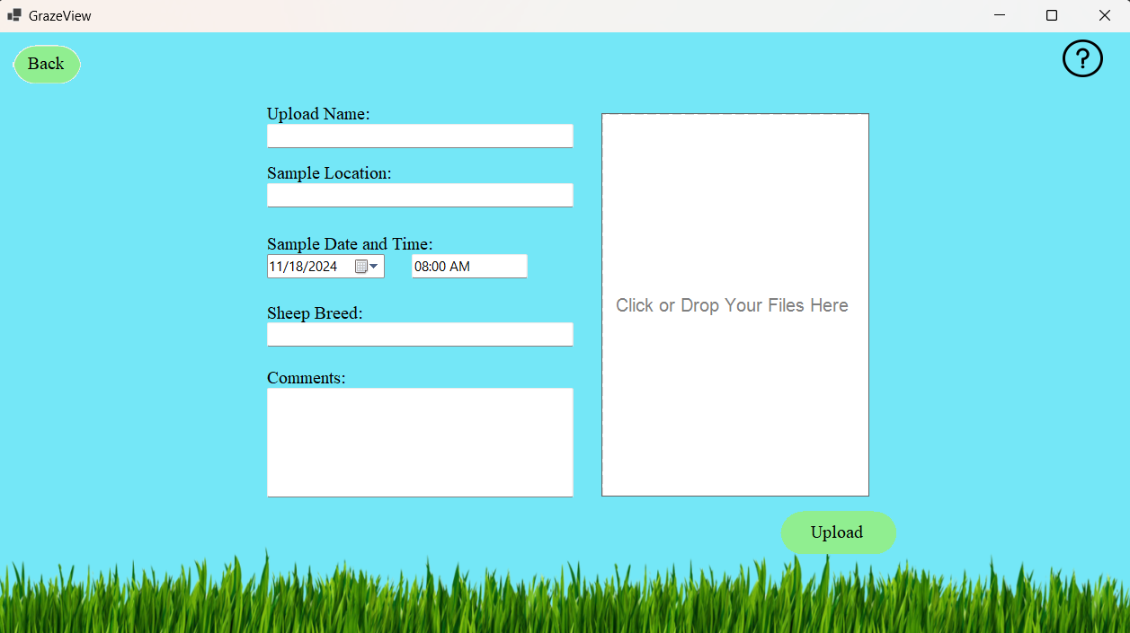
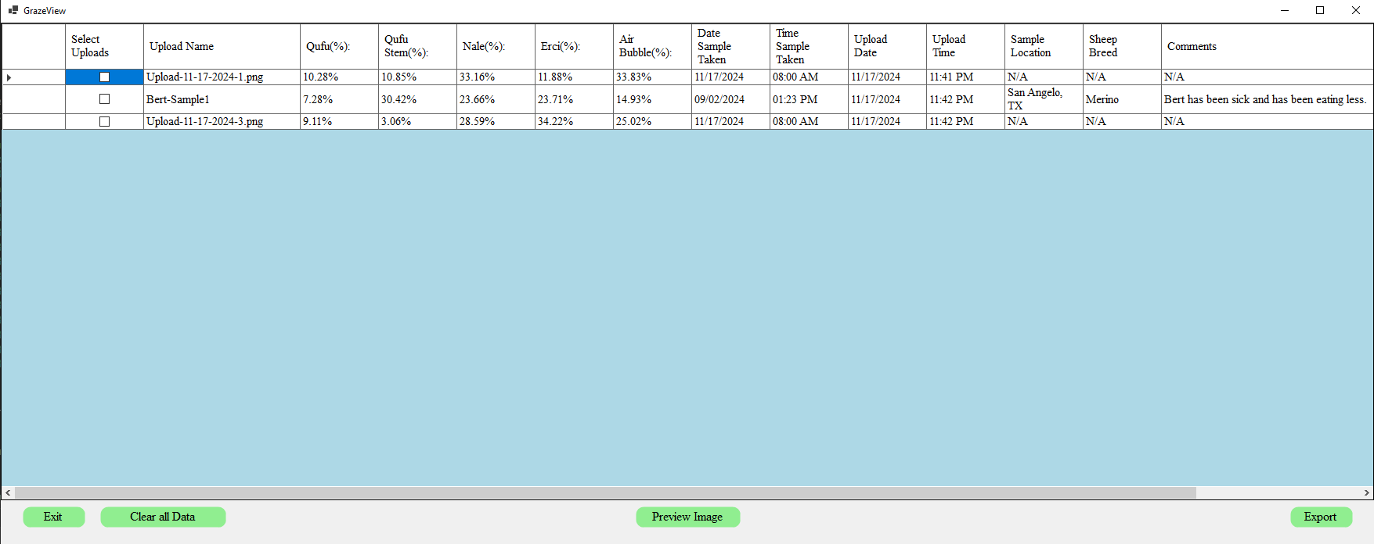
Subsystem Overview - UI Functionality
Jack Nelson
User Upload
Allow User Input Fields
Image Upload
Sample ML Data Generation
Data Library/Storage
Store all Uploads in an organized manner
Store all Uploads on Application Close
Loading Screen
Demo Loading Screen to show realtime ML progress
Export Functionality
Allow User to export, view, and print data
Event Handling

Slide 6
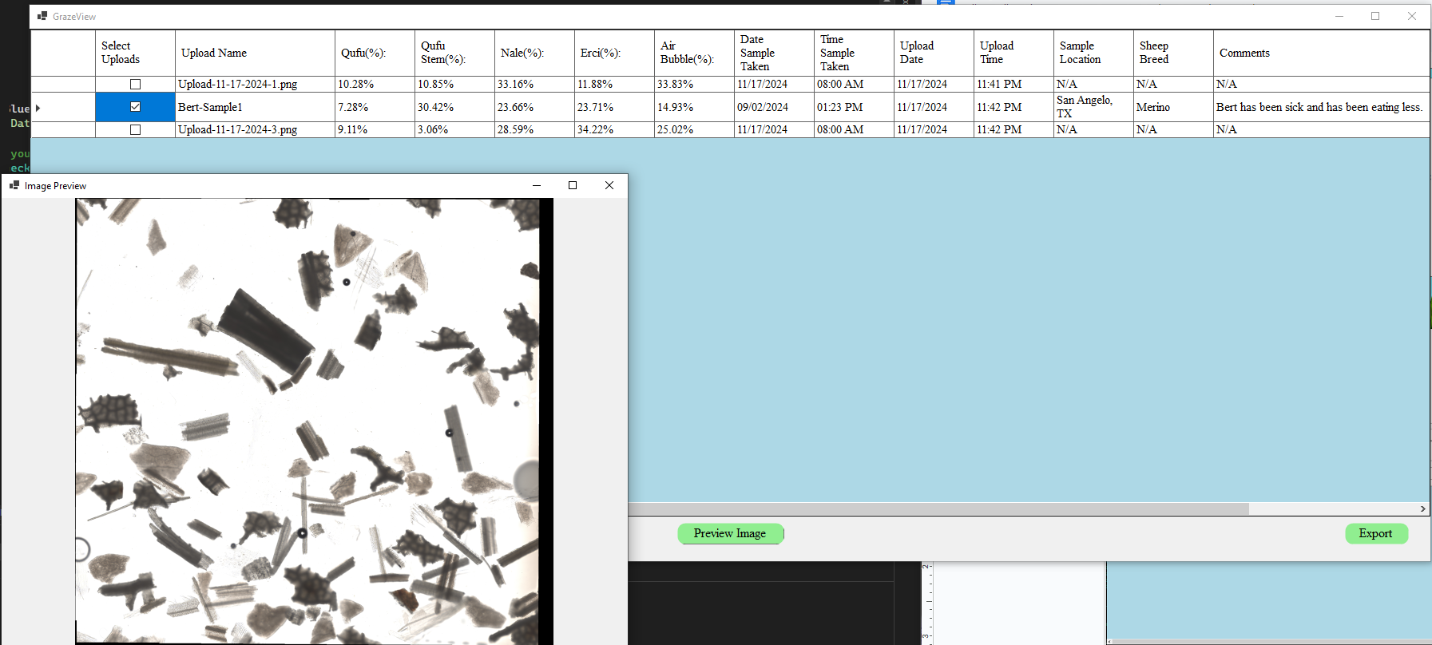
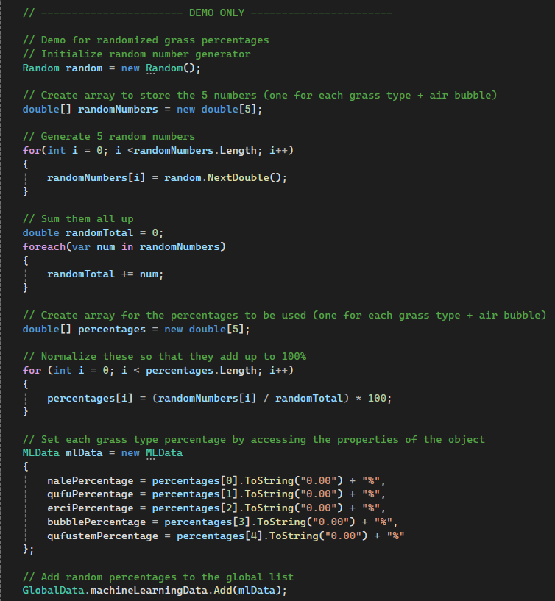
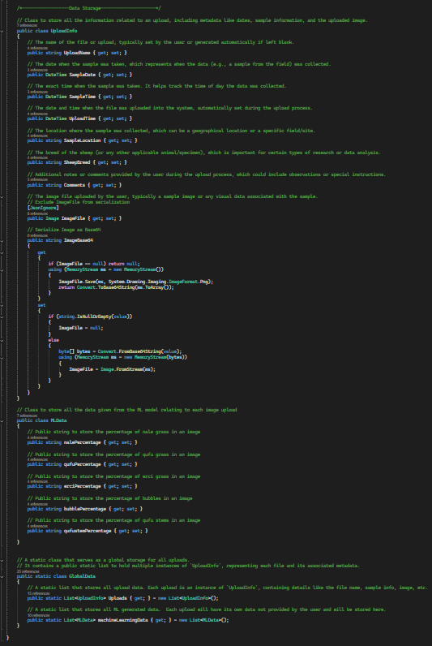
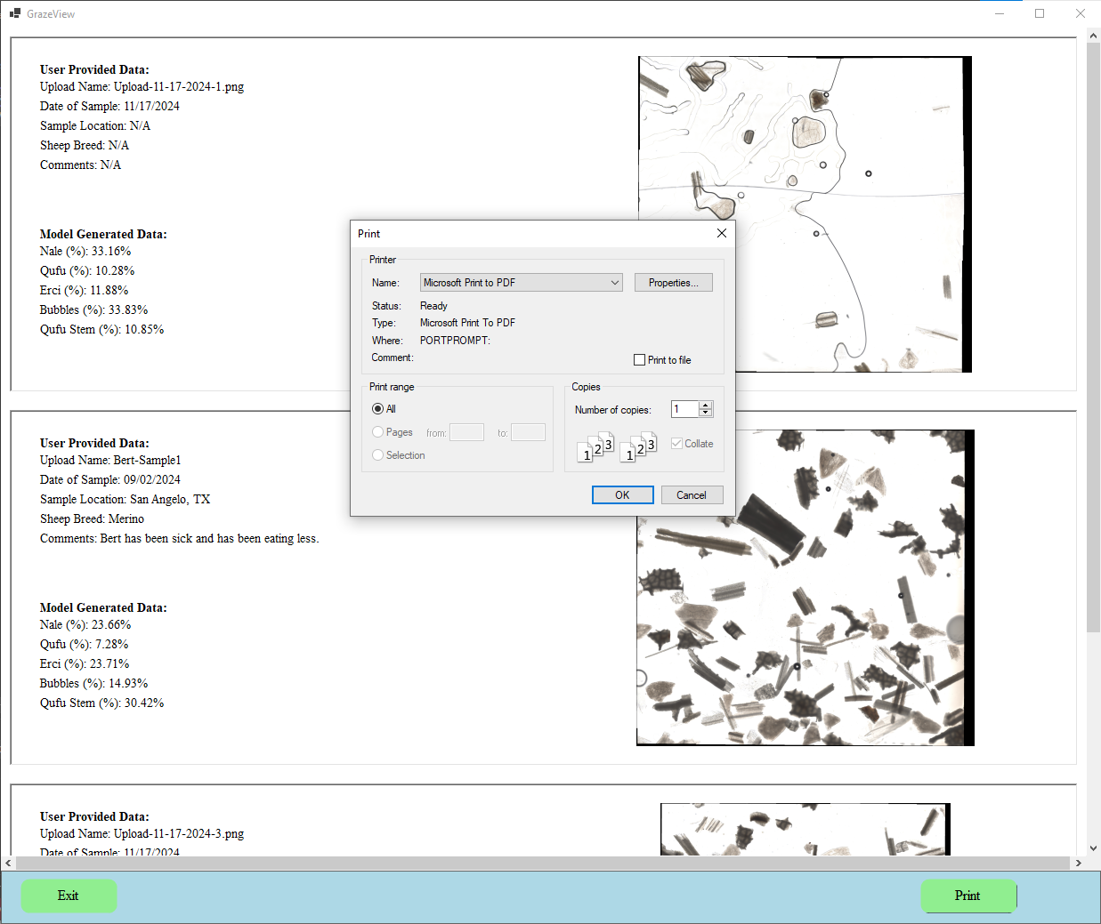
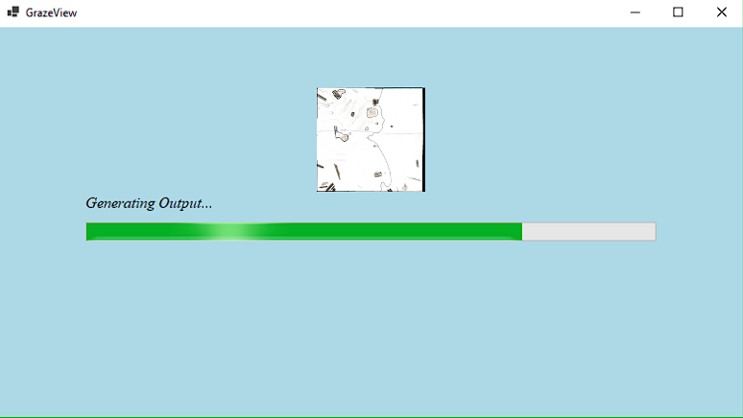
Subsystem Overview - UI Functionality
Jack Nelson

Slide 7
Subsystem Overview - UI Functionality
Jack Nelson
Test | Success Criteria | Results
Fluid User Interface | All design components operate and are organized in a user-friendly fashion. Any and all resizing events are correctly handled, without layout errors. | User Interfaces functions as intended, with no bugs when handling resizing events.
New Image Data Input | New Data is uploaded and successfully passed. | New data is able to be uploaded and properly stored. There is minimal delay when uploading large image files.
Uploaded Data Storage | The application is successfully able to store data once the application is closed, and the application is successfully able to access this data once ran once more. | All data is correctly stored on close and correctly accessed. We have encountered one small bug with this function, that causes the text size to change in the data library when accessed.
U.I. Help Guide | Each page will have access to a User Help Guide. Only one instance can be opened at one time. | User guide is accessible from all pages, and only one instance can be opened.
Interface Output Results | The Winforms Application will be able to take user input and generate sample data to be output, in a visually organized manner. | Generated ML data is created and User Input is correctly passed to display output.

Slide 8
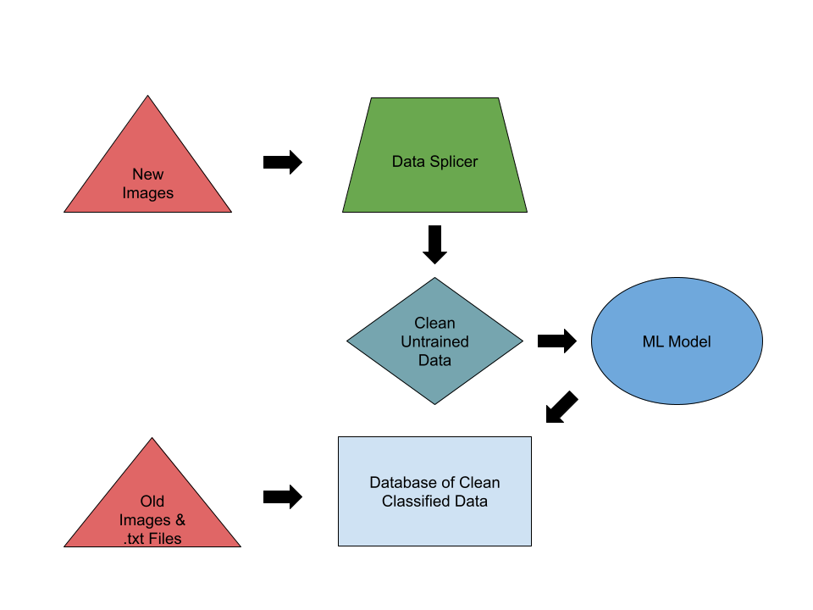
Database
Arnav Gokhale
Manages training, validation, and test datasets, ensuring the machine learning model is trained on accurate, well-labeled data.
Builds automated pipelines for data collection, preprocessing, and feeding into the machine learning model, reducing manual intervention.
Works closely with the machine learning model to optimize predictions.
Prepares and cleans raw data (microscopic images) for accurate analysis by the
model.

Slide 9
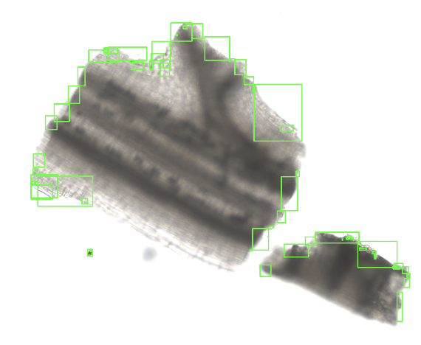
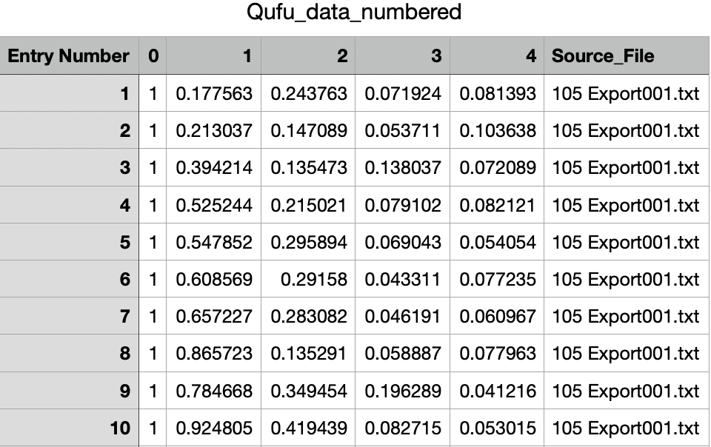
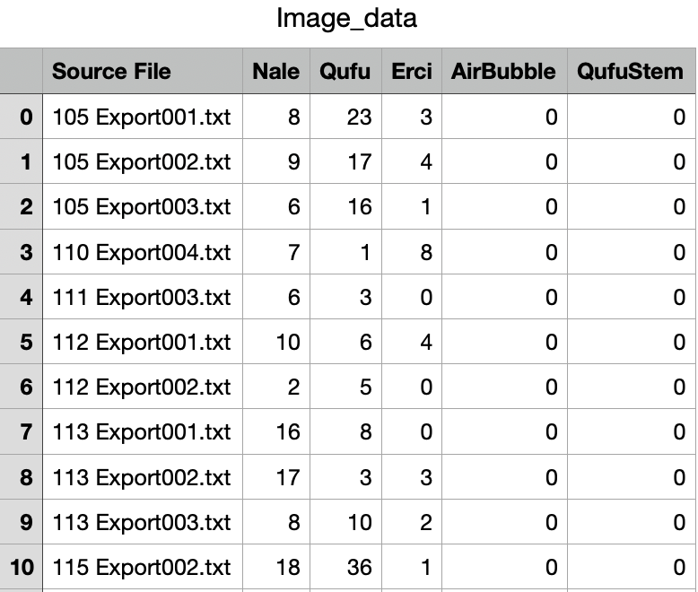
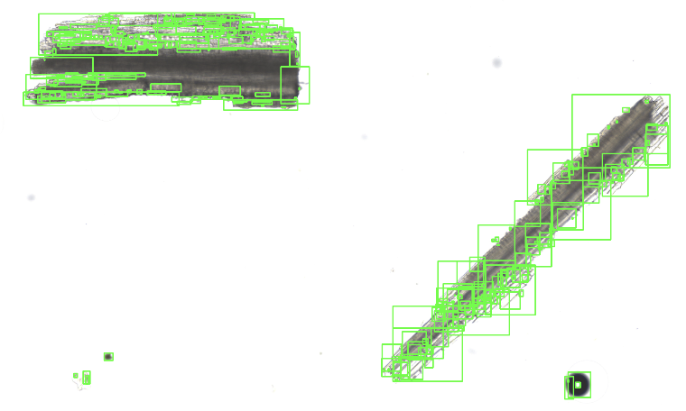
Database
Arnav Gokhale

Slide 10
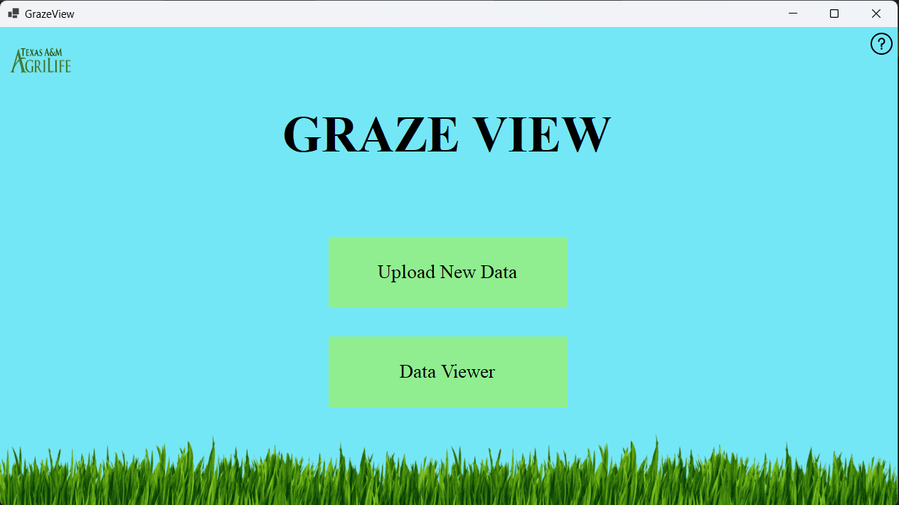

Subsystem Overview - UI Visual Design
Nate Scott
Designed all pages to be seen by the user:
Placed and positioned components (buttons, labels, textboxes, panels, etc.)
Resize components according to how the user resizes the form
Apply background designs for most pages (colors, images, logos, etc.)
Ensured consistent properties across all forms, components, text, etc.
Current problems in progress:
Background design for Results page to be completed
Need to embed design resources to the project (additional files and images used)
Apply logo or additional branding
Main Page
Logo (to be inserted)

Slide 11
Subsystem Overview - UI Visual Design
Nate Scott
Data Upload Page
Data Library Page

Slide 12
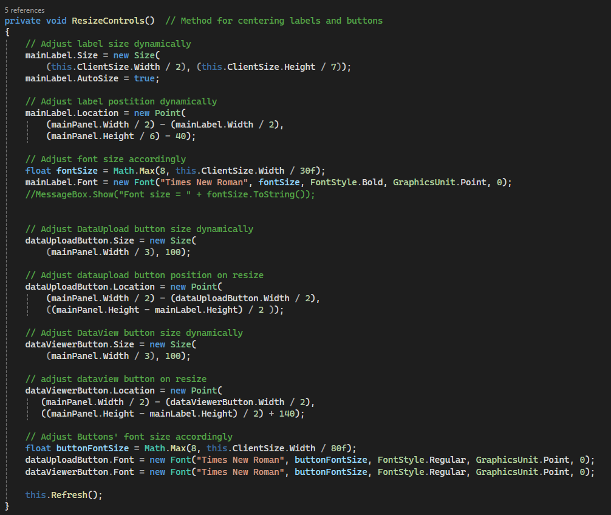
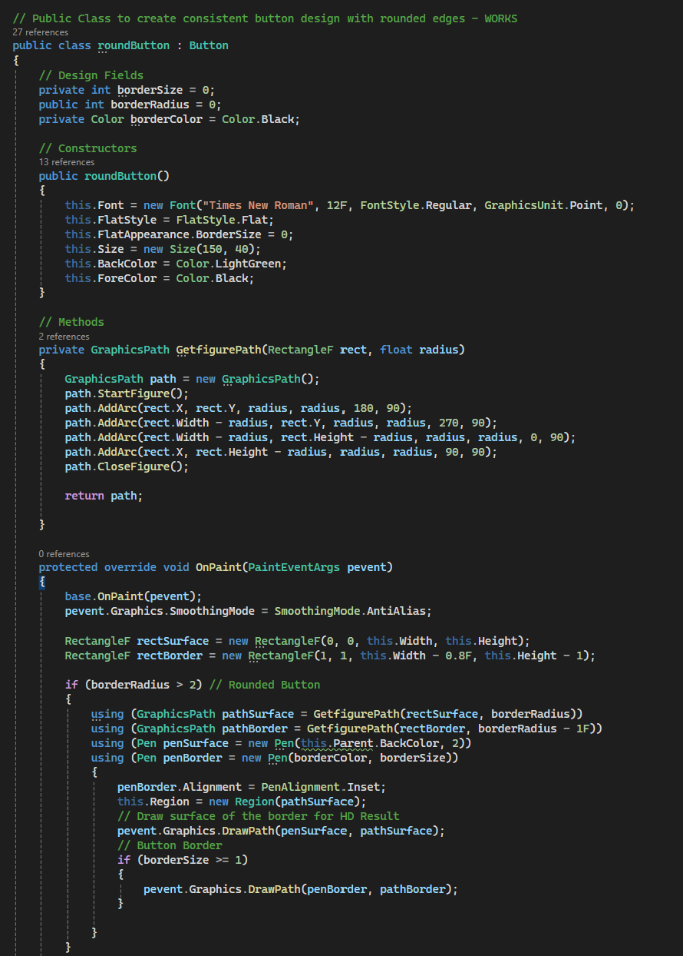
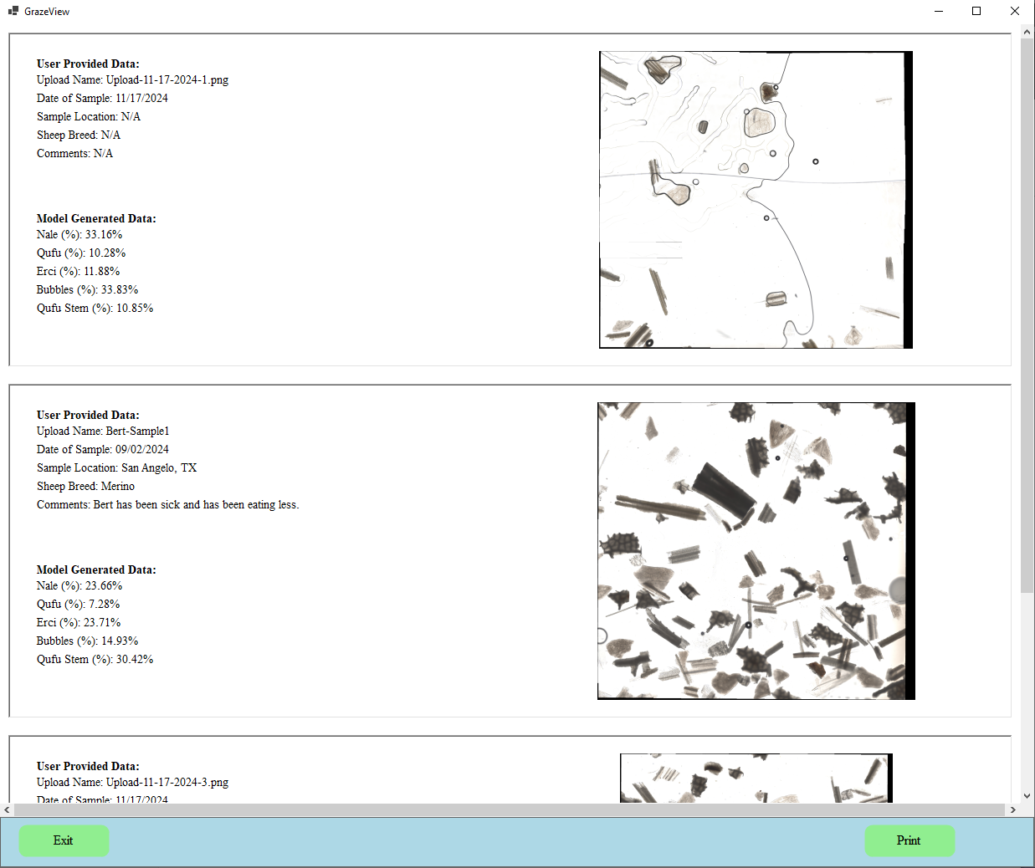
Subsystem Overview - UI Visual Design
Nate Scott
Code for handling window resizing
Code for creating a unique Round Button component
Data Library Expanded View Page for Exporting

Slide 13
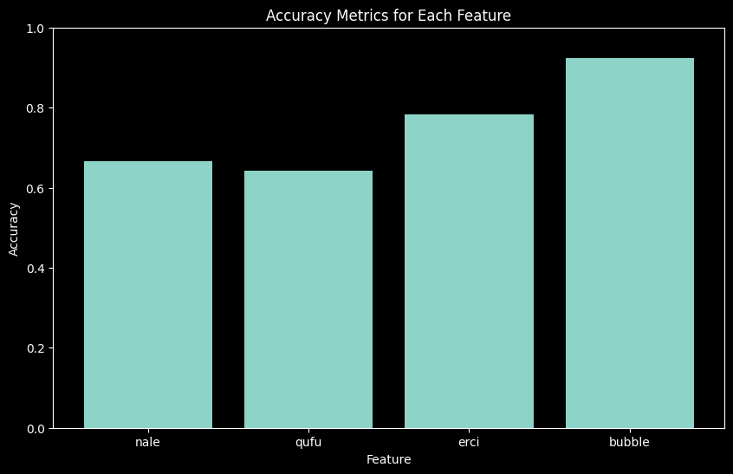
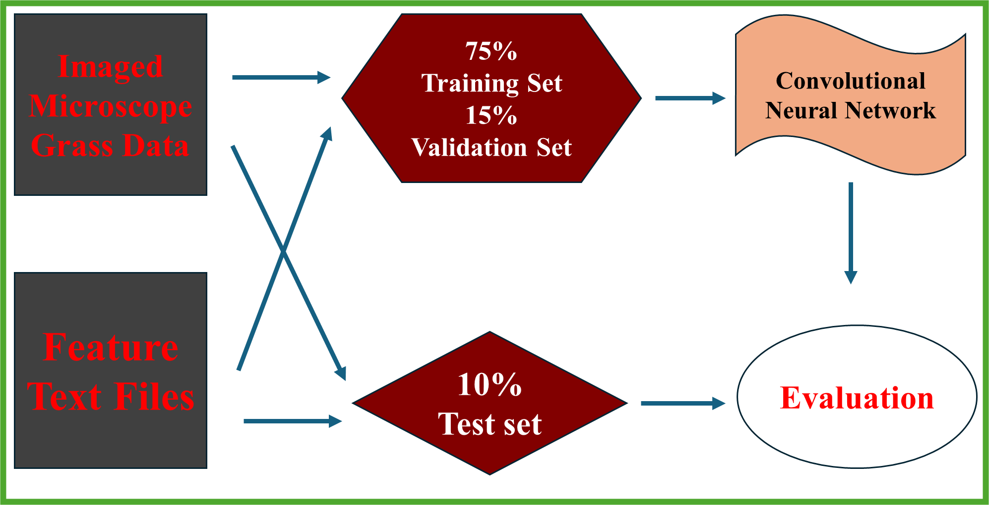
Machine Learning Model
Godson Edewor
403 Designed:
Five Feature Convolutional Neural Network
Feature Percentage Mapping
Dataset to Model Flow
403 Validated:
80% Overall Model Accuracy
~7 Minute Training Time

Slide 14
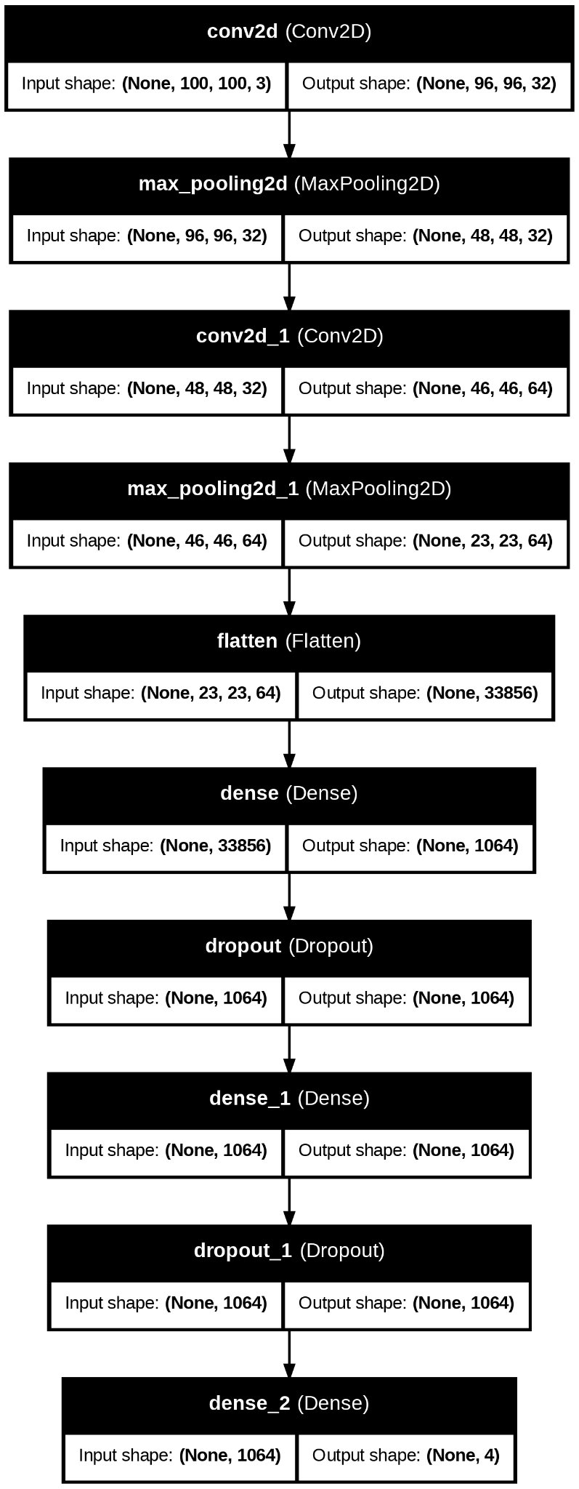
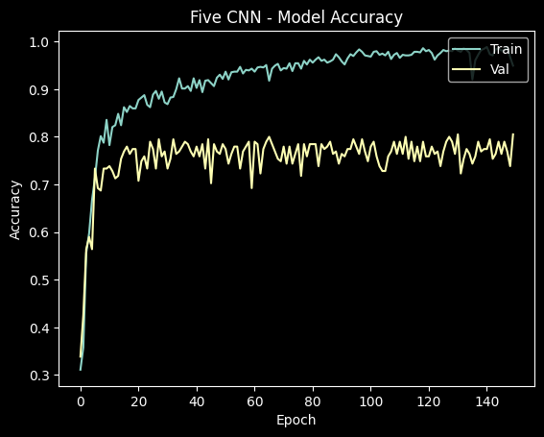
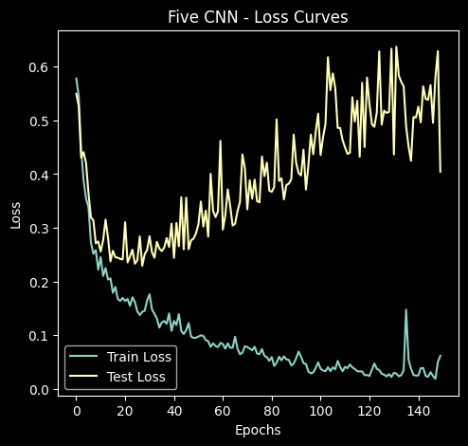

Slide 15
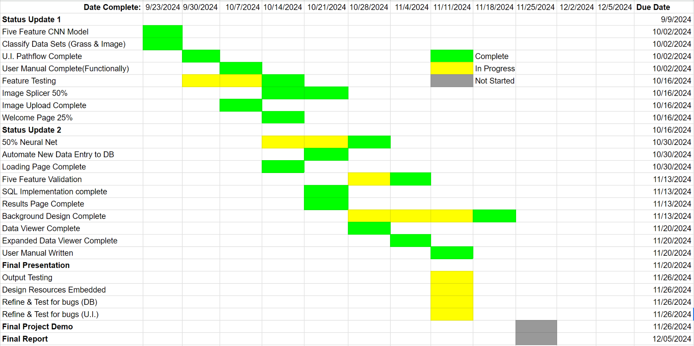
Execution Plan

Slide 16
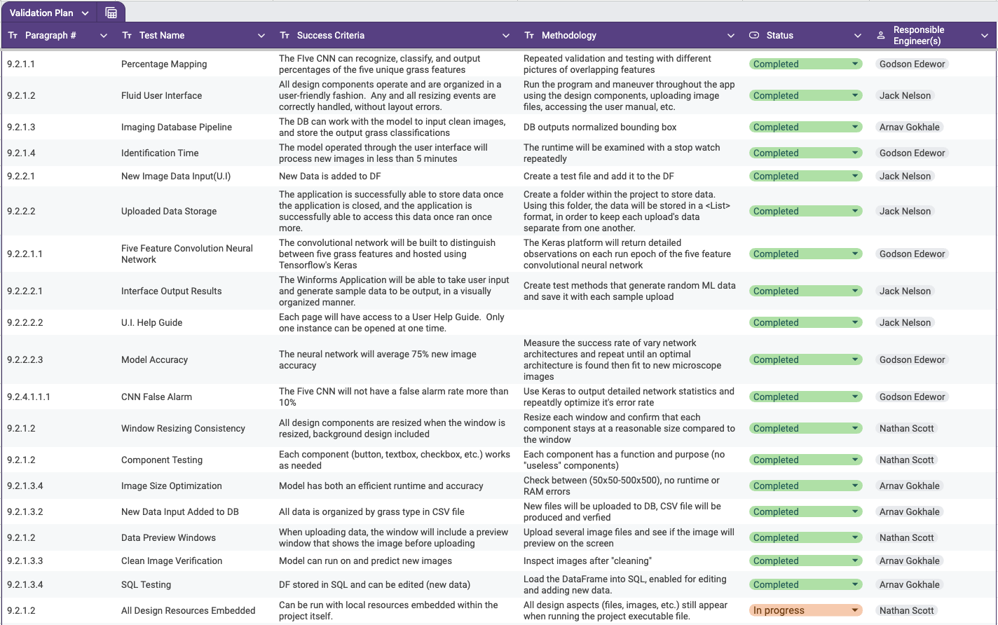
Validation Plan

Slide 17
Remaining Tasks
Tasks | Date
ML model: Final Feature Validation, Error Testing | Nov 24th
U.I. : Correct demo database access formatting, Testing for Bugs | Nov 24th
U.I. : Embed design resources to the project | Nov 24th
DB: Increase Image Splicer Accuracy | Nov 24th
404 Planning:
Machine Learning Model: Full database connection, User Interface interconnection, ML to App testing/validation
Database: Pipeline to model testing, model to database pipeline testing, as well as data image viewer
U.I. - Visual Design: Labeling sections of image content for the user to see, after uploading the image

